Slide 1
Developing Apps for Touch and Mobile Devices

Slide 2
Objectives
In this session, you will learn to:
  Identify different types of prototyping
  Develop apps for the Windows Phone 8.1 platform

Slide 3
Desktop Prototyping
The process of creating prototypes on desktops is known as desktop prototyping.
Mobile UX designers can create desktop prototypes by using:
  Simple software tools, such as PowerPoint.
  Advanced software tools, such as Axure, JustInMind, Proto.io, and Framer, which are created especially for the purpose of desktop prototyping.
Based on the type of software tool, desktop prototypes for mobile UX designs can be created in the following ways:
  Using the simple method
  Using the advanced method

Slide 4
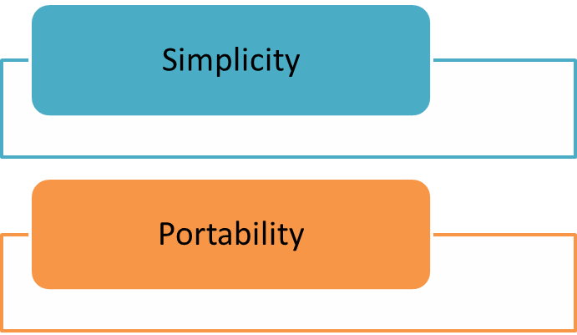
Desktop Prototyping (Contd.)
Using the Simple Method
The simple method involves using a presentation software application, such as PowerPoint and Apple keynote, to create a mobile prototype.
To use simple method, perform the following steps:
  Design various screens of an app on separate pages or slides of the presentation.
  Verify the sequence of screens in which you want to show the mobile UX.
  Show the mobile UX to the reviewers anytime by running the slides in the presentation mode.
Consideration for deciding the software application:

Slide 5
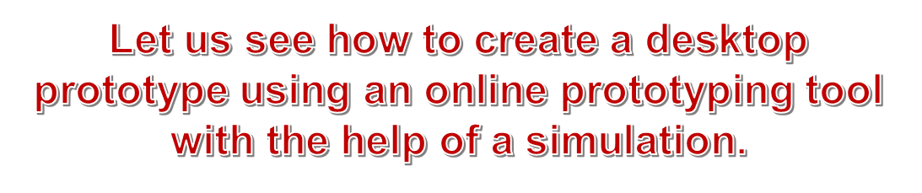
Desktop Prototyping (Contd.)
Using the Advanced Method
The advanced software tools enable you to make your prototype interactive through clicks, gestures, and touch events.
You can use a number of advanced software tools, such as Adobe Flash, to create prototypes.
You can use any desktop prototyping tools, such as Axure, JustInMind, Proto.io, and Framer.
The consideration you need to make is that the prototype is simple and portable.

Slide 6
Device Prototyping
The process of creating of mobile prototypes that can be tested on the real device, is known as device prototyping.
Device prototyping enables UX designers to provide a more realistic look and feel of an app to users.
It also allows users to provide more accurate feedback related to the app.
Device prototypes can be of the following types:
  Image prototypes
  Clickable prototypes

Slide 7
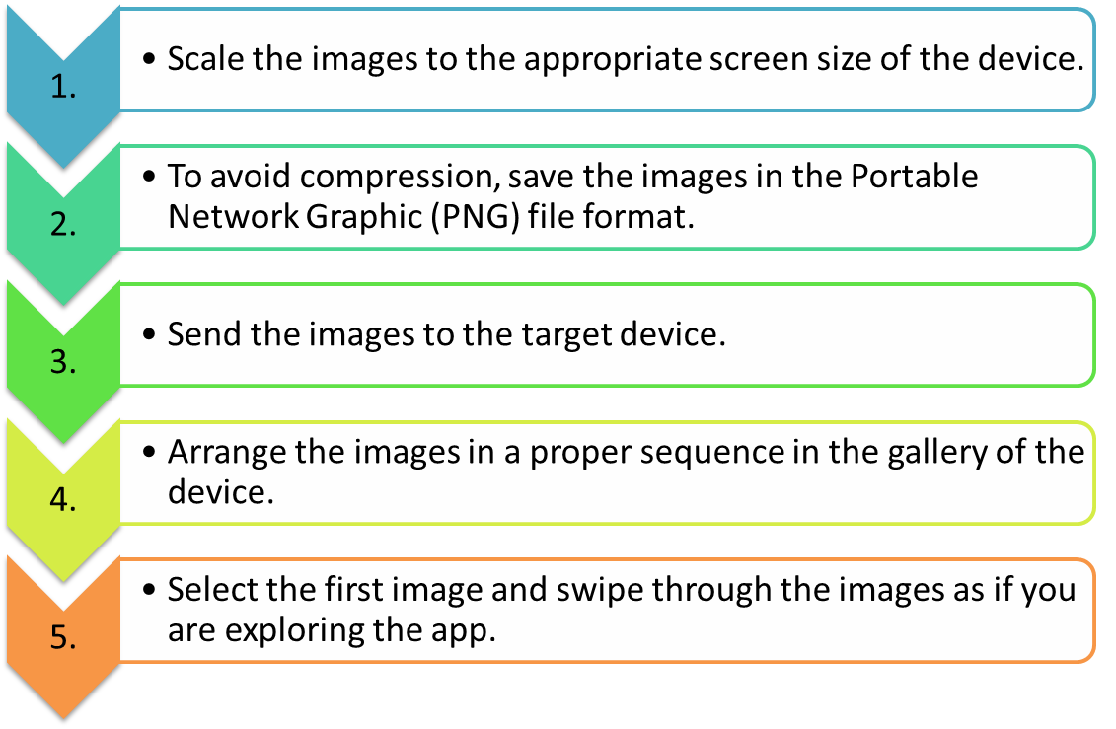
Device Prototyping (Contd.)
Image Prototypes
The image prototype involves creating images for the various screens of the app.
The steps required for image prototyping are:

Slide 8
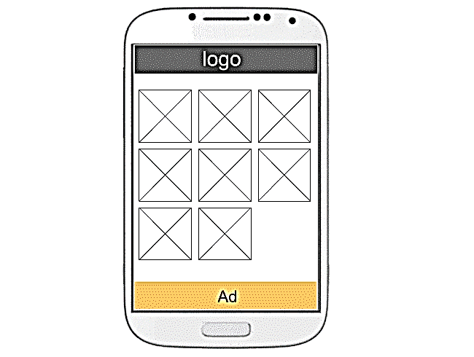
Device Prototyping (Contd.)
The image prototype is a simple and effective method in gathering quick feedback.
You can record the users’ feedback about the mobile UX for each screen.
In case you want to replace an existing image with a new screen, send the new image to the device replacing the existing one in the gallery.
Image Prototype on a Device
One of the limitations of image prototypes is that these are not interactive because these are not clickable.

Slide 9
Device Prototyping (Contd.)
Clickable Prototypes
Clickable prototypes are interactive because these allow reviewers to navigate through the app.
These prototypes allow you to link the various screens of the app.
You can use HTML5 to create a clickable prototype.
One of the advantages of using HTML5 is that it is free and it is quite easy to edit and maintain HTML pages.
Factors that you need to consider while designing mobile screens using HTML5:
  To set the width of the screen to the target device.
  To focus on providing a basic navigation path, such as:
    Linking pages together
    Adding clickable areas to explore pages
    Including simple input fields to launch the keypads and the dialer

Slide 10
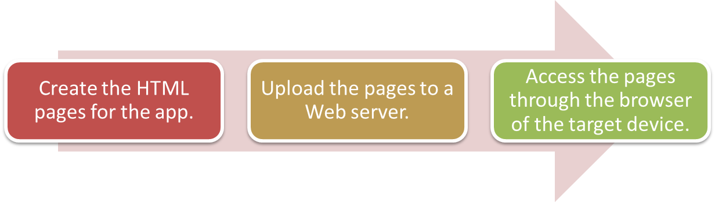
Device Prototyping (Contd.)
The steps required for clickable prototyping are:
Such a realistic experience enables reviewers to share more valuable feedback.
The prototype can be made more interactive and realistic by:
  Creating it directly on the target device.
  Including various gestures and touch events.
To create such prototypes, a number of prototyping apps, such as
POP and Invision, are available.

Slide 11
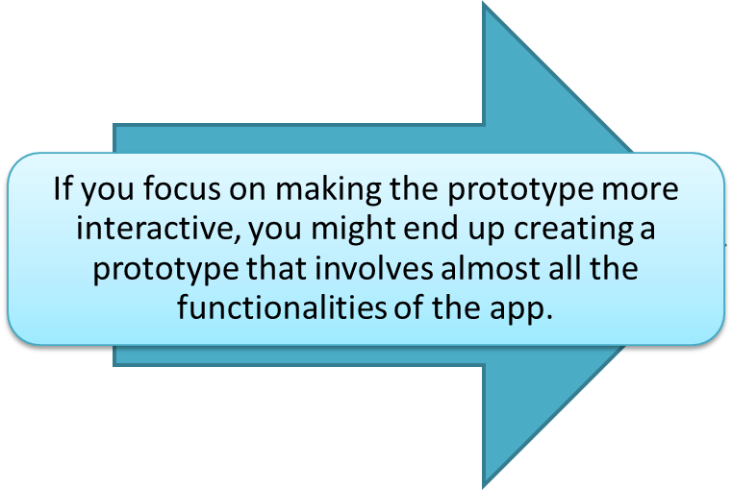
Device Prototyping (Contd.)
A prototype is considered effective if it is developed quickly to gather quick feedback and disposed easily.
Such a prototype will take a long time to develop. In such a situation, you might get trapped in the prototype.
The prototype trap is a situation that indicates that you are spending excess time on the prototype.
In such a case, the goal of creating a prototype to gather quick feedback is lost.

Slide 12
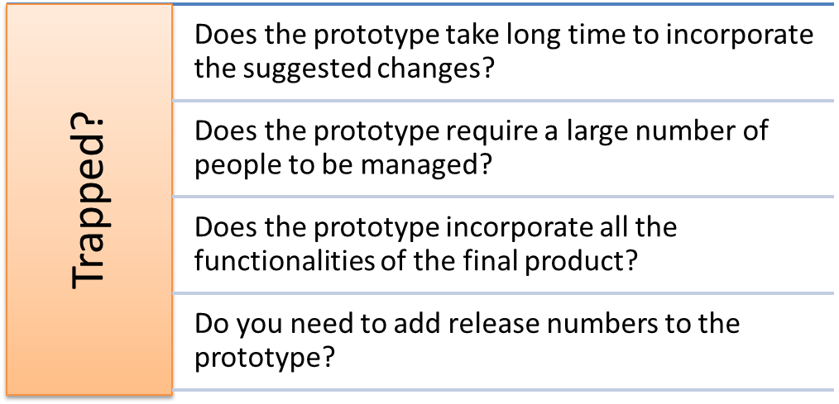
Device Prototyping (Contd.)
To verify whether you are trapped, answer the following questions:
If the answer to any one of the questions is yes, you need to rethink whether you are creating a prototype or the app itself.

Slide 13
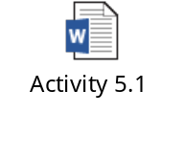
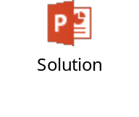
Activity 5.1: Creating a Desktop Prototype
Problem Statement:
Solution:

Slide 14
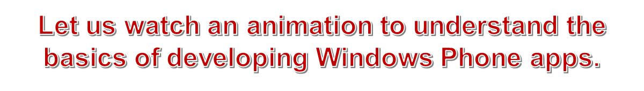
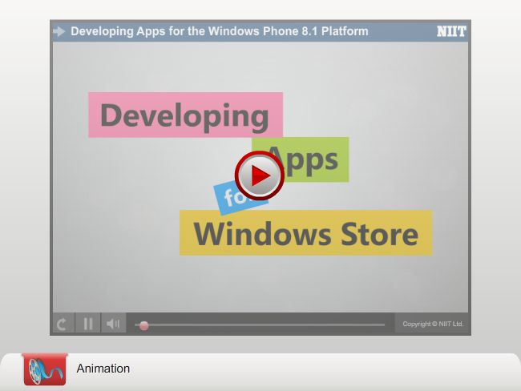
Platform Convergence – A Brief History and Overview

Slide 15
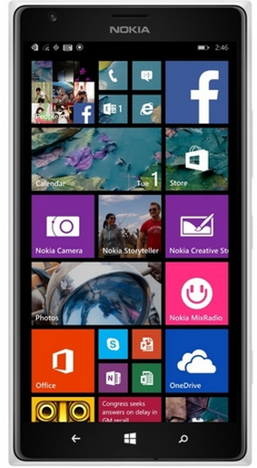
Platform Convergence – A Brief History and Overview (Contd.)
Platform convergence between Windows and Windows Phone was initiated with Windows Phone 8.
Windows Phone 8 has the support for a small subset of Windows Runtime APIs.
Windows Phone 8.1
The release of Windows Phone 8.1 is a big step towards platform convergence.

Slide 16
Platform Convergence – A Brief History and Overview (Contd.)
Simi
The similarities in Windows 8.1 and Windows Phone 8.1 are:
Windows Runtime APIs
Application Lifecycle
UI framework
Windows 8.1
Windows Phone 8.1
Some differences exist between the behavior and supported features of Windows Phone and Windows due to the difference in:
  Basic nature of phones and computers
  Sizes
  The manner in which people use them
The new SDK allows you to develop new kind of applications,
called Windows Phone Store apps, which target Windows
Phone 8.1.

Slide 17
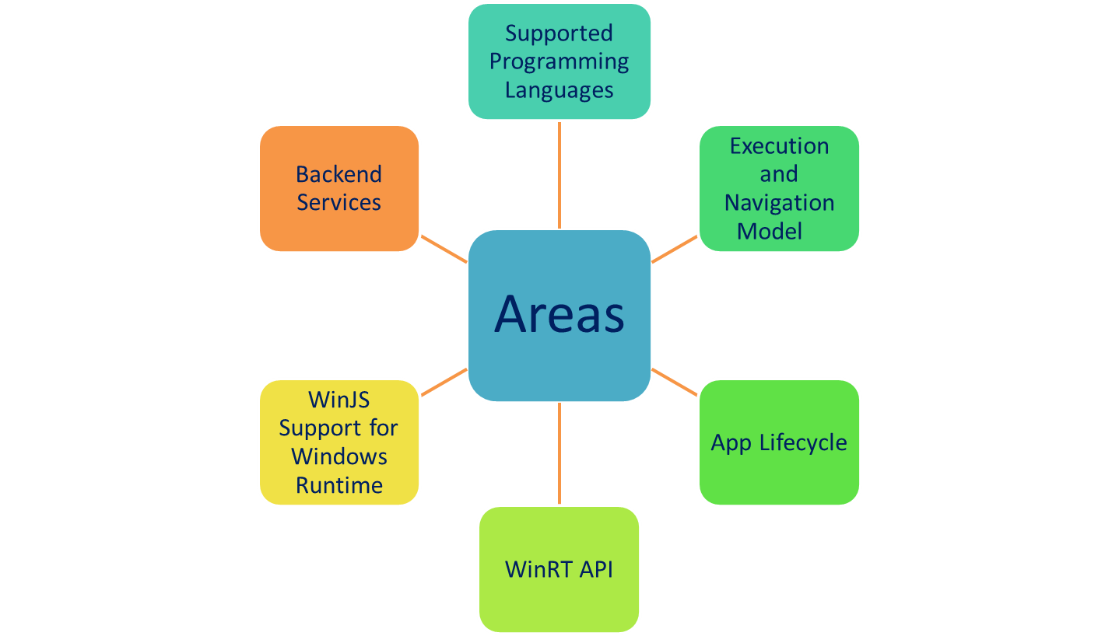
Convergence Areas
  The convergence between Windows 8.1 and Windows Phone 8.1 has been implemented in the following major areas:

Slide 18
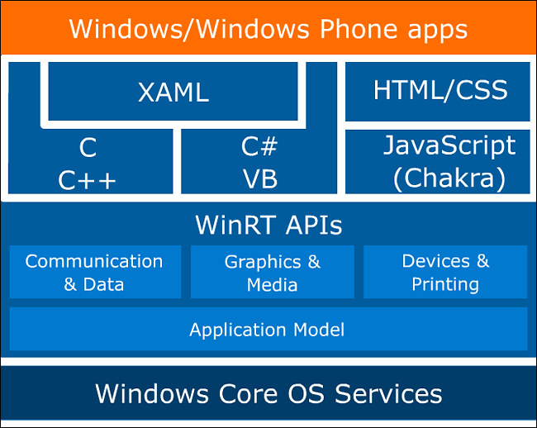
Convergence Areas (Contd.)
  You can use any of the following technologies to develop Windows Phone 8.1 apps:
  C#/VB with .NET and XAML
  C/C++ with XAML
  JavaScript and HTML
  In Windows 8.1, the execution model supports both Windows and Windows Phone platforms.
Developers can access the APIs with the help of programming languages, such as C, C++, C#, Visual Basic, and JavaScript.
The navigation model is similar for Windows and Windows Phone.
Architectural Diagram of Windows and Windows Phone

Slide 19
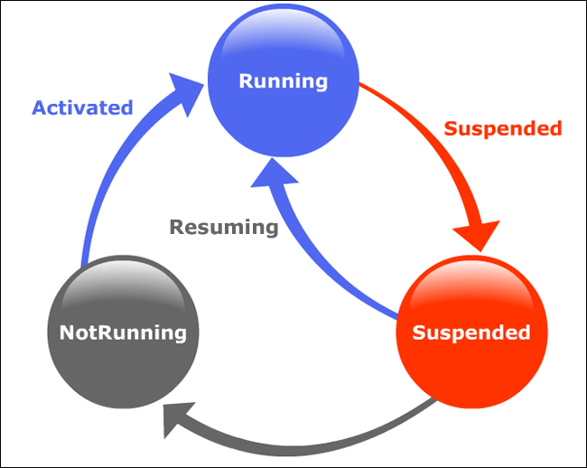
Convergence Areas (Contd.)
The following figure shows the app lifecycle.
The app has not been launched or the app was previously running but later crashed or the app was suspended and then terminated by the system because of low system resources.
When app is launched by user.
When the user switches from app to another or when the device enters a low power state.
Phases of App Lifecycle

Slide 20
Convergence Areas (Contd.)
  WinRT API:
  Windows Phone 8.1 has support for complete Windows Runtime (WinRT) API.
  Most of the WinRT APIs such as file input/output APIs, live tiles APIs, and mapping APIs, are available on the Windows Phone 8.1 platform.
  WinJS support for Windows Runtime:
  Windows Library for JavaScript (WinJS) is an open source library for developing apps by using HTML, JavaScript, and CSS.
  WinJS allows you to develop native apps for Windows Phone 8.1 by using JavaScript and HTML.
  Backend Services:
  Push notifications
  Shared entitlement
  App roaming

Slide 21
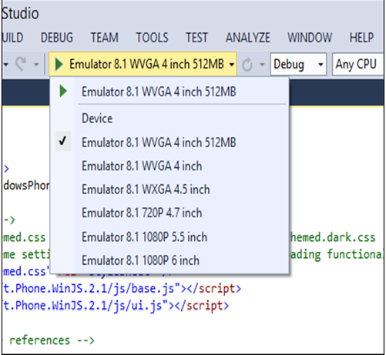
Development Tools
To develop Windows Phone 8.1 apps, you need:
  The Windows Phone 8.1 SDK
  The Windows Phone 8.1 emulator
The Windows Phone 8.1 development tools are included with Visual Studio 2013.
For running and testing your apps, you can connect the actual device with your computer or use an emulator.
There are different screen sizes and resolutions of emulators available, on which you can test your apps for different types of devices.
Emulator Resolutions and Screen Sizes

Slide 22
Development Tools (Contd.)
The emulator for Windows Phone 8.1 allows developers to simulate geolocation and accelerometer data for their apps in Visual Studio.
  To detect the device location by using geolocation, you need the Internet connection.
  Apps that display driving directions make use of geolocation data.
Geolocation refers to the process of identifying the position of a device with the help of:
  Global Positioning System (GPS)
  Wi-Fi connection
  IP address location
Accelerometer is a sensor that identifies the orientation and tilt direction of mobile devices.
  When a user changes the position of a device, accelerometer sensor records the change.
  For example, changing the orientation of an image (landscape or portrait) according to the device orientation.

Slide 23
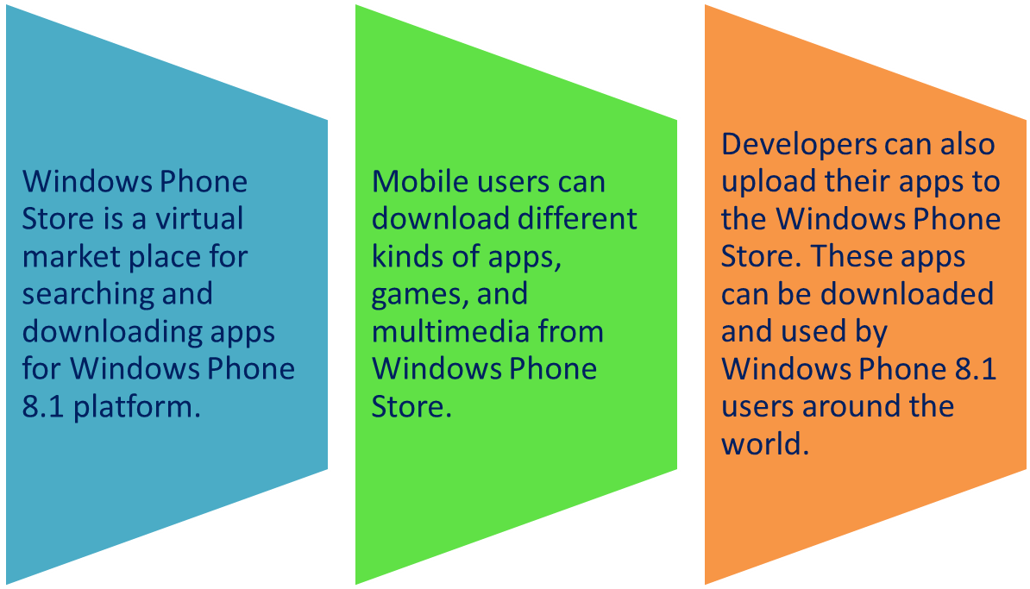
Windows Phone Store Apps
The Windows Phone Store apps are based on the new Windows Runtime APIs.

Slide 24
Project Templates Available for Windows Phone 8.1
In Visual Studio, you can find different templates for developing Windows Phone applications.
Visual Studio provides the following project templates for developing Windows Phone apps:
  Blank App
  Pivot App
  Navigation App

Slide 25
Project Templates Available for Windows Phone 8.1 (Contd.)
The Blank app project is used to create single-page Windows Phone apps.
  When you compile and run a blank app, you get a screen with a text placeholder.
  When you select a Blank App project, your application will not have any predefined layouts and controls.
  When you create a project by using the Blank App template, some of the files are implicitly added to the project.
The following table shows the files of a Blank App template and their description.
File | Description
default.html | Contains the default HTML markup for the app. You can add UI elements on this page.
default.js | Contains the JavaScript code corresponding to the default.html file.
default.css | Contains the default CSS code for the default HTML page.
ui-themed.css | Contains the reference link of the ui-themed.css file. When the ui-themed.css file is referenced in an app, the WinJS checks the theme on the device when the app is executed. The ui-themed.css file refers to ui-themed.theme-dark.css or ui.themed.theme-light.css, according to the preference set by the user on the device.
package.appxmanifest | Contains information about the identity, capabilities, and deployment process of the app.

Slide 26
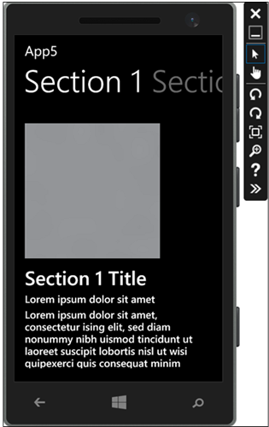
Project Templates Available for Windows Phone 8.1 (Contd.)
Pivot App
  A Pivot app uses a Pivot control.
  A Pivot control acts as a container for another control known as the PivotItem control.
  The PivotItem control contains page content in the form of other controls, such as grids, lists, and links.
  Pivot apps are generally used for:
  Filtering large datasets
  Displaying multiple datasets
  Switching between the app views.
  The Pivot control has in-built support for navigation and touch interactions.
  When you create a project by using the Pivot template, some of the files are implicitly added to the project.
Output of the Pivot App

Slide 27
Project Templates Available for Windows Phone 8.1 (Contd.)
The following table shows the files of a Pivot template project and their description.
File | Description
default.html | Contains the default HTML markup for the app.
navigator.js | Defines the navigation model of the app.
hub.html | Acts as a container page for sections or pages of the app.
sectionNumberPage.html(section1Page.html) | Contains HTML code for each pivot page. By default, it contains section1Page.html, section2Page.html, section3Page.html, and section4Page.html files.
sectionNumberPage.js(section1Page.js) | Contains the corresponding JavaScript file for each sectionNumberPage.html.
item.html | Represents a full page view of an item.
item.js | Contains the corresponding JavaScript code for the item.html file.
phone.css | Contains the default CSS code.
hubPhone.css | Specifies the CSS style for pivot control and pivot pages.
package.appxmanifest | Contains information about the identity, capabilities, and deployment process of the app.

Slide 28
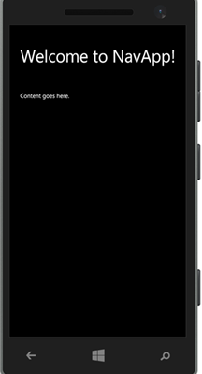
Project Templates Available for Windows Phone 8.1 (Contd.)
Navigation App
The Navigation template provides in-built navigation capabilities to a Windows Phone 8.1 app.
An app created by the Navigation template includes a single home page but you can add more pages to the project by adding the Page Control from the Add New Item option.
When you create a new Windows Phone app by using the Navigation template and execute it, the output of the app appears on the emulator, as shown in the figure.
  When you create a project by using the Navigation template, some of the files are implicitly added to the project.
Output of the Navigation App

Slide 29
Project Templates Available for Windows Phone 8.1 (Contd.)
The following table shows the files of a Navigation template project along with their description.
File | Description
default.html | Gets loaded first when an app is executed. This page contains a page control into which different HTML pages can be loaded dynamically. The UI elements added to the default.html file will be available on all the pages of the app.
default.js | Contains the corresponding JavaScript file for the default.html file.
navigator.js | Contains the JavaScript code for implementing the navigation functionality.
default.css | Contains the default CSS code for the default.html file.
home.html | Contains the home page UI elements. This file is referenced by the default.html file when an app is executed.
home.js | Contains the corresponding JavaScript code for the home.html file.
home.css | Contains the corresponding CSS code for the home.html file.
package.appxmanifest | Contains information about the identity, capabilities, and deployment process of the app.

Slide 30
Summary
In this session, I learned that:

